Slide 1
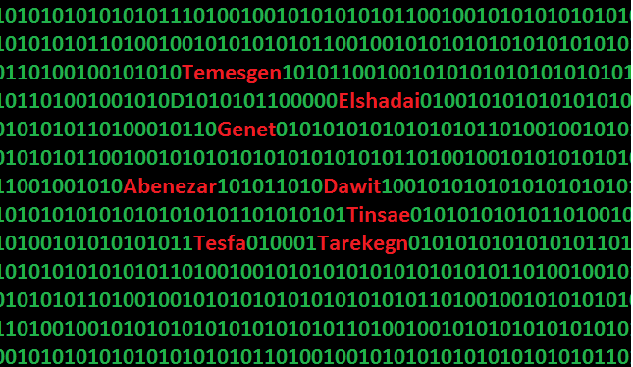

Slide 2
Student Information Management
Making teaching easier

Slide 3
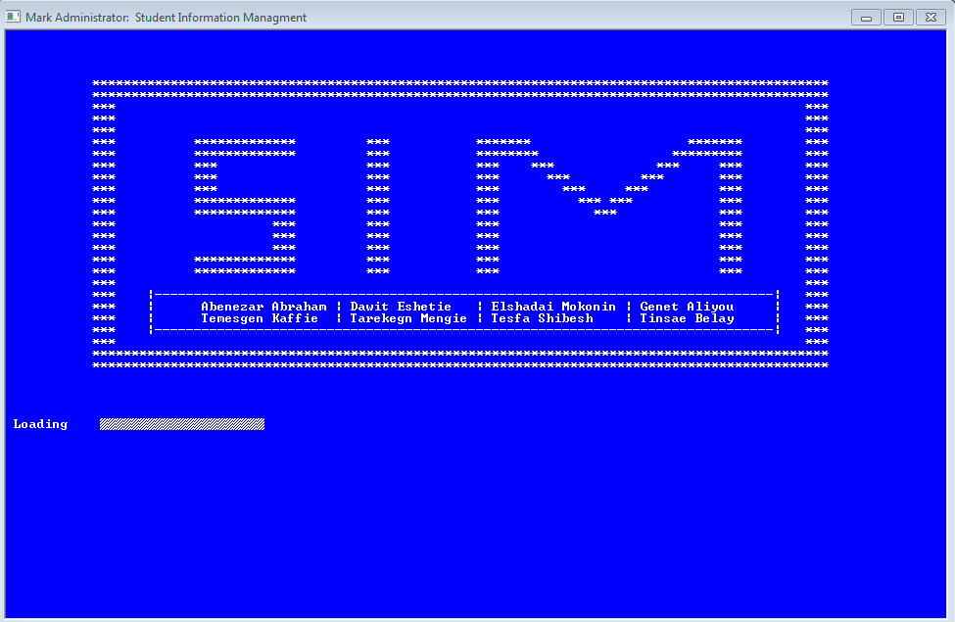

Slide 4
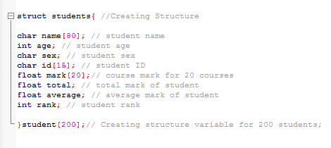
Program Variables and Structure

Slide 5
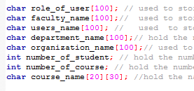
Program Variables and Structure

Slide 6
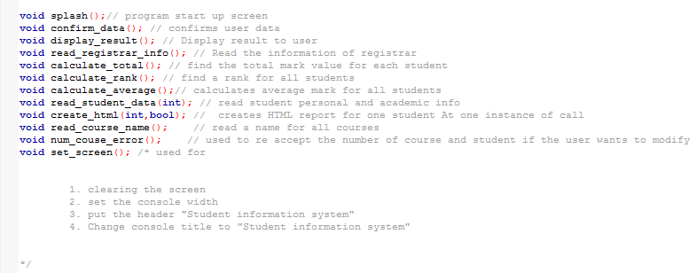
Functions

Slide 7
Program Features
Accept information of Organization who use this program.
Organization Name
Faculty Name
Department Name
A name and role of person entering the data of students.

Slide 8
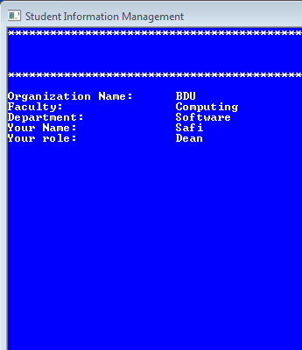

Slide 9
Program Features
Accept student personal data
Name
Age
Sex
ID

Slide 10
Program Features
Accept student Academic data
Number of course he/she take
A name of each courses
A mark of student in each course

Slide 11
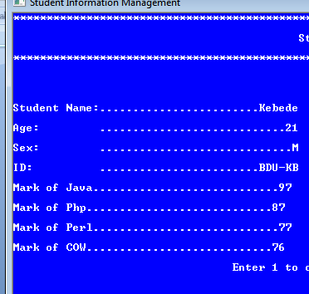

Slide 13
Program Features
Program asks the user of a program to confirm the data he/she entered is correct.
If there exist any mistakes the user can modify
Only the part of mistake without starting from the scratch

Slide 14
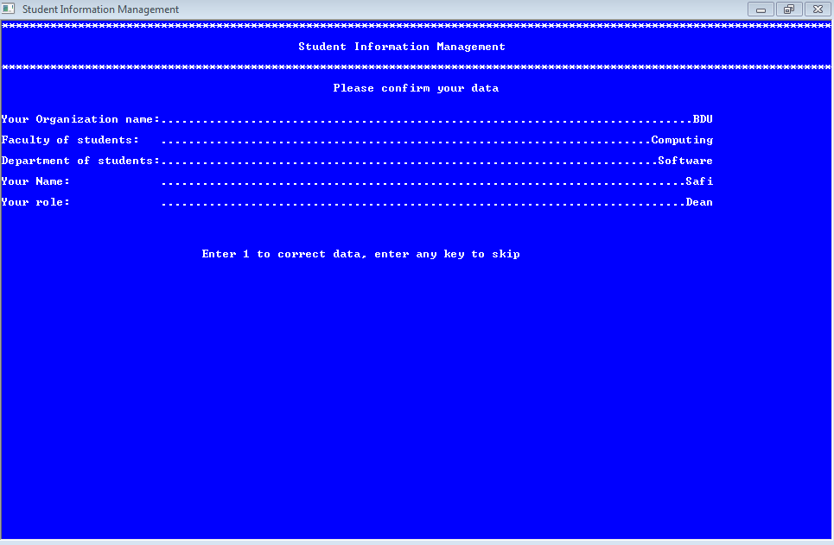

Slide 15
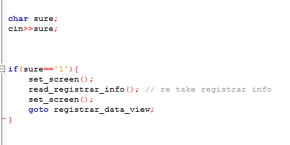

Slide 16
Program Features
Calculates a total mark for all students by adding the mark each course a student take.

Slide 17
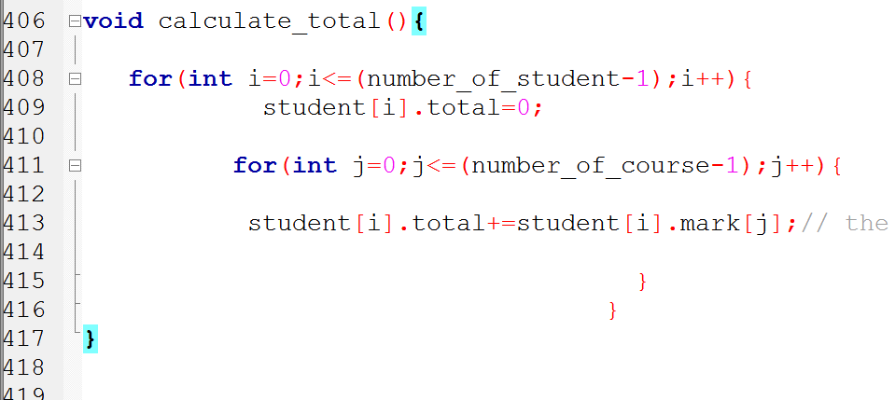

Slide 18
Program Features
Calculates a average mark for all student by dividing the total mark value by number of course they take

Slide 19
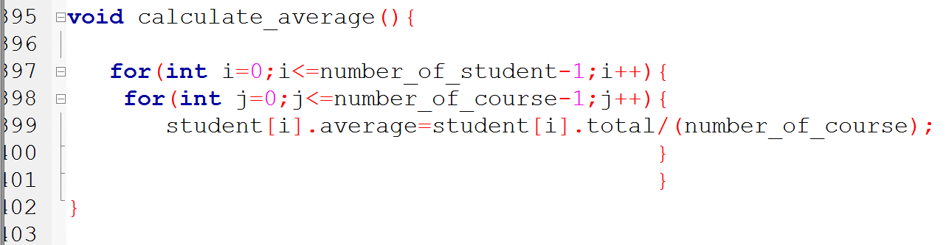

Slide 20
Program Features
Calculate the rank of student by comparing students total mark with other students total mark.
The rank of student will be the number of students who have a greater total mark than the student plus one ( 1 )

Slide 21
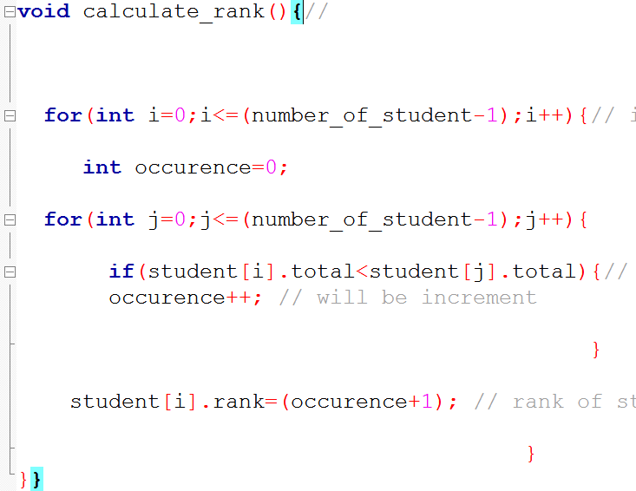

Slide 22
Program Features
Program asks the user to create a Transcript for all students.
If user wish to create the reports , program saves transcript of all students in documents folder permanently. (Windows Only)
If user says no it skips

Slide 23
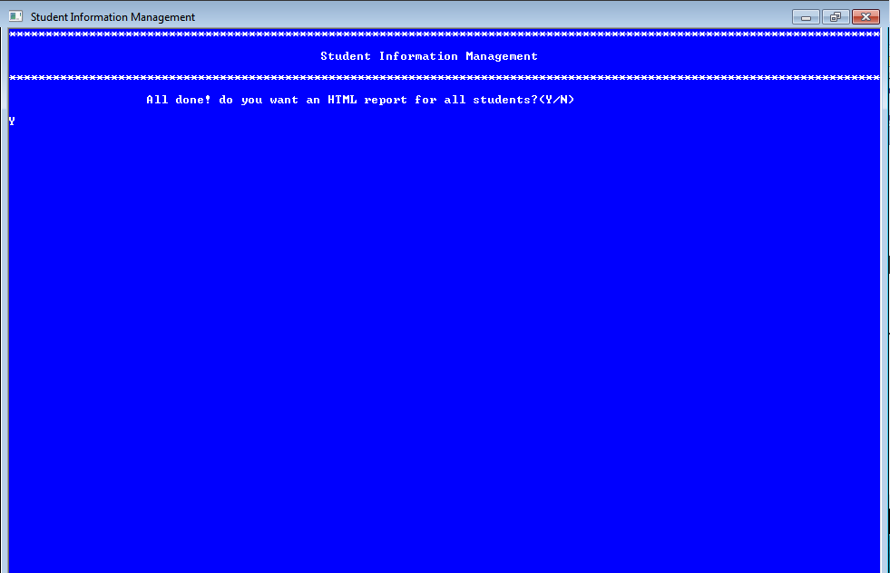

Slide 24
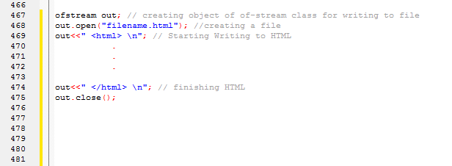

Slide 25
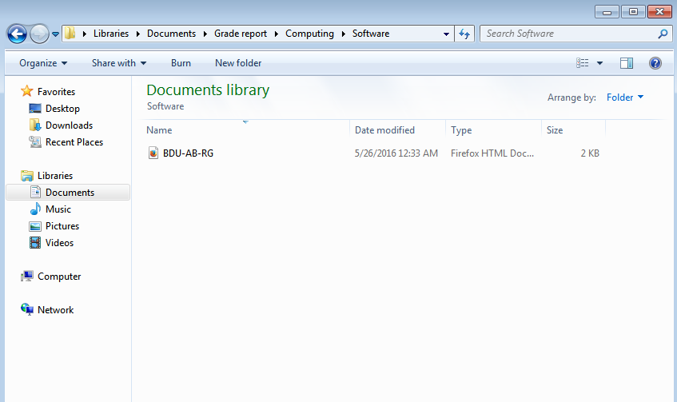

Slide 26


Slide 27
Program Features
The program asks the user to enter students ID to see the result.
And display result of student who's ID is matched with entered ID.

Slide 28

Variables used to search ID

Slide 29
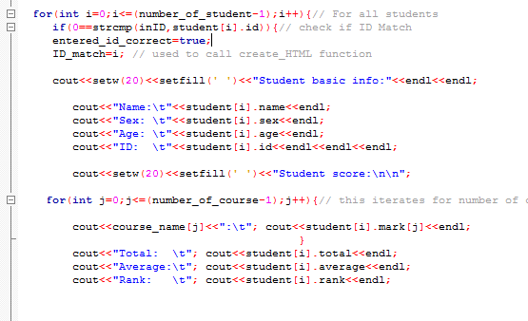
How ID is searched

Slide 30
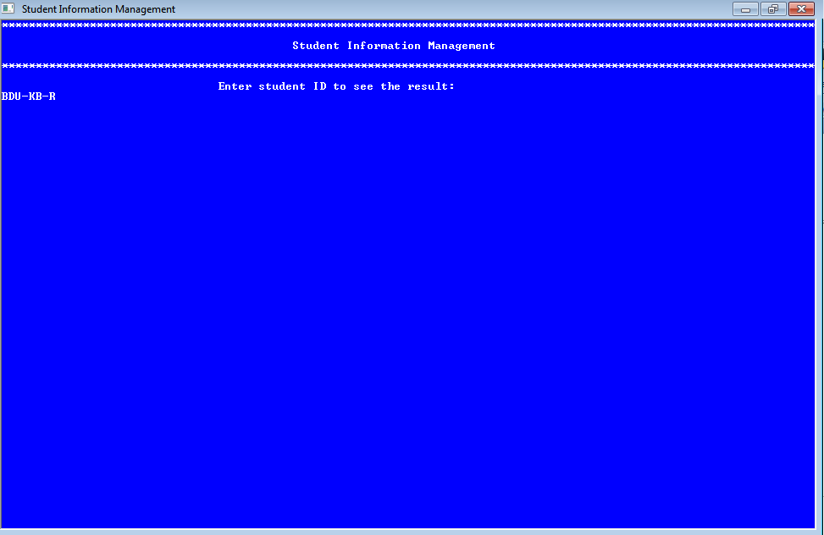

Slide 31
Program Features
If the entered ID do not match any of students ID the program will pop up an error telling the user ID is not correct.

Slide 32
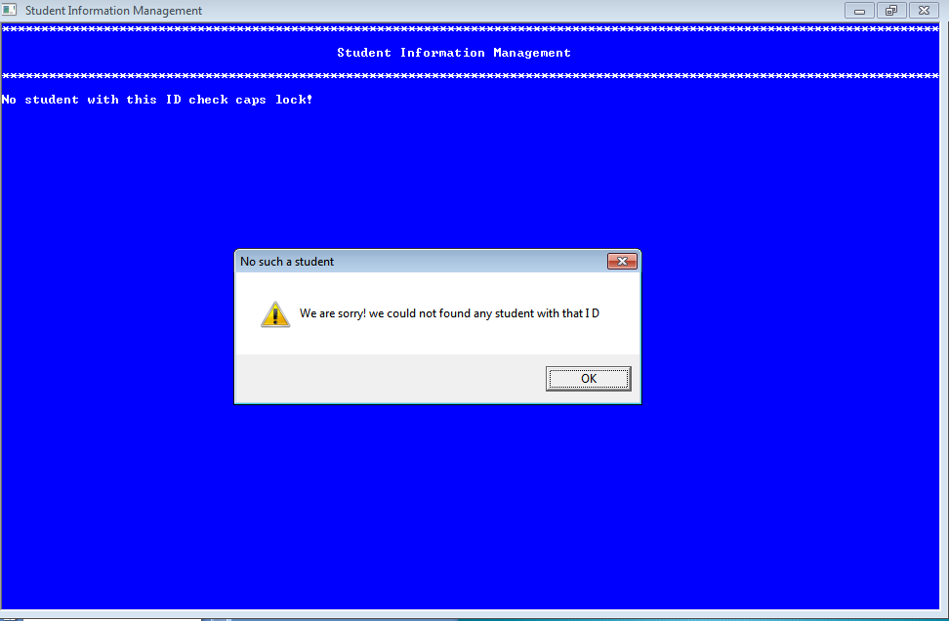

Slide 33
Program Features
A program also narrate the student personal detail and academic score while displaying student result and
Asks the user to open the transcipt of the student via Browser

Slide 34
Program Features
Program will ask student ID to display student result again. (recursive)

Slide 35
Other Features
Transcript – (HTML + JavaScript + CSS)
Sound Narration-( VBScript )
Message Box-( VBScript )
File Operation
Create Folder- ( DOS )
Remove Folder -( DOS )
Documents path- ( DOS )
Delete file -( DOS )
Move Files -( DOS )

Slide 36
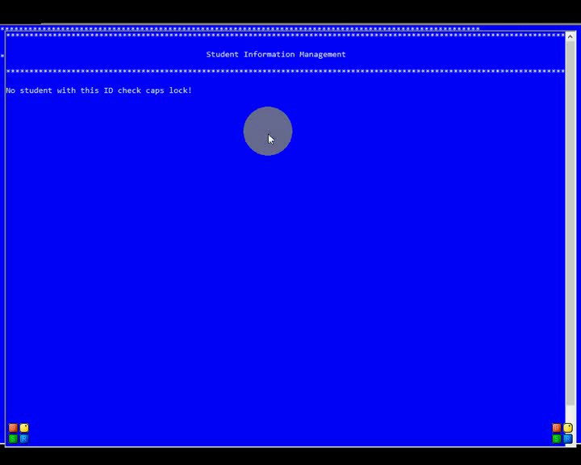

Slide 37
Message Boxes
1. Success (Info)
2. Warning
3. Error

Slide 38
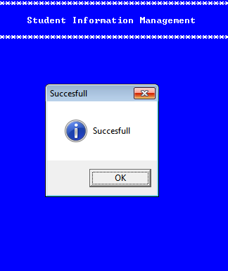

Slide 39
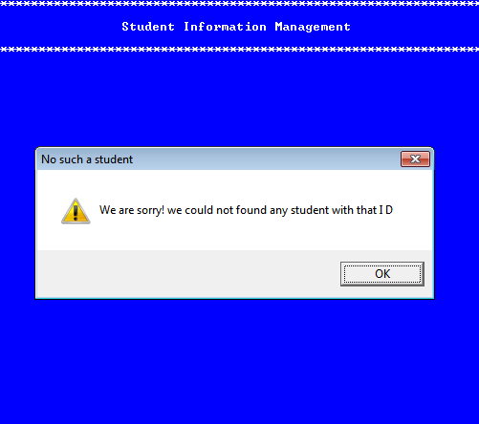

Slide 40
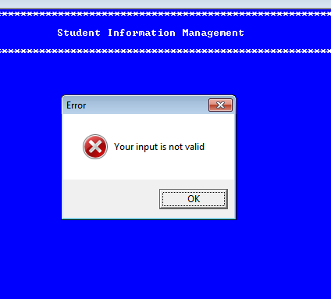

Slide 41
DOS Commands Used
MD – Create directory ( Folder )
RD – Remove Directory ( Folder )
MOVE – move file or folder
DEL – delete file or folder
COPY –copy file or folder
%homedrive%%homepath%\documents –location of document folder

Slide 42
Languages used in Transcript
HTML – the skeleton
CSS – to format texts
JavaScript – to automatically open print window

Slide 43


